Slide 1
Carlisle Town Meeting
Presentation Guidelines and PowerPoint Template
April 2025
Prepared by
Wayne Davis, Town Moderator
1

Slide 2
How to Name Your File
Please use this convention:
  [Article #] [Brief Topic Identifier] (Your Name)
  Examples:
  10 Budget (Clark)
  25 SitePlanReview (Jones)
On this template, put the Town Meeting Date & Article Number in the footer.

Slide 3
How to Set-Up PowerPoint
Choose Design>Slide Size either standard (4:3) or widescreen (16:9) ratio, whichever works best.
Recp,,emd black font on light tan (Design> Format Background)
  White background picks up glare when projected
  Light tan RGB settings = 255-230-153
  Light tan fades to a non-glare neutral when projected

Slide 4

Basic Text Guidelines - 1
Less is more
  5 bullets per slide maximum
  8 lines of text maximum
  1 level of sub-bullets maximum
    i.e, don’t go to this level
Keep your font size large
4

Slide 5
Basic Text Guidelines - 2
DO’s
Use modern sans-serif fonts such as Calibri, Aptos, or Verdana.
Choose a font and stick to it
For emphasis, use
  Bold
  Italic
  Red (or other high contrast color)
DONT’s
Avoid serif fonts
Don’t use Arial
Don’t underline
DON’T SHOUT WITH ALL CAPS!!!
5

Slide 6
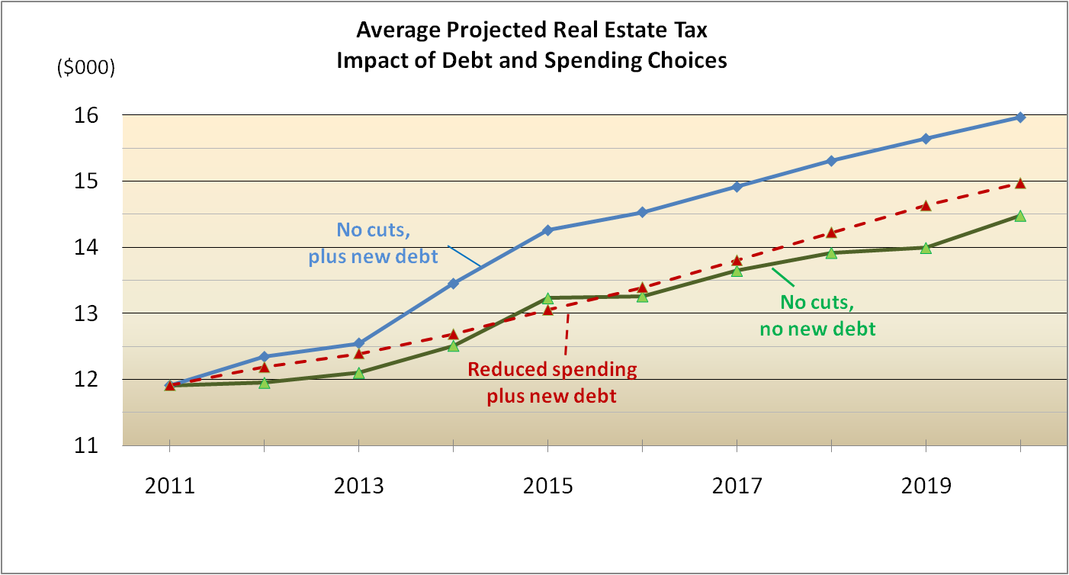
Example of Effective Chart
See the slide notes
(View>Notes) for extra tips
6
Notes:
This slide shows a chart pasted from Excel. Several changes were made, both in Excel and Powerpoint, to make it more effective for Town Meeting:
Vertical axis labeled with units as $000 leaves more room to use a larger font.
Vertical axis uses unlabeled minor grid lines.
Horizontal axis only labels every other value. These are years, and so the missing values are obvious. Leaves slide uncluttered, and more room to make font larger.
Data lines use differing, dark, and high-contrast colors, along with different patterns.
Data lines weight increased to 2.75 points.
Each data line labeled next to the line, rather than confined to a key box off to the side. Viewers don’t need to move eyes back and forth to read the lines.

Slide 7
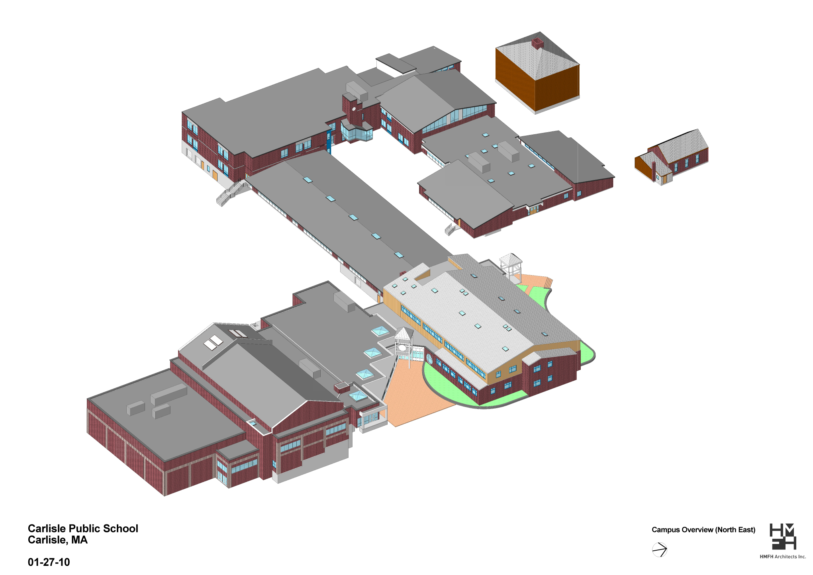
Diagrams
& Maps
Highland
School Street
Brick
Wilkins
New Building
See the Slide Notes for extra tips
Corey
Church Street
Notes:
A Picture is Worth a Thousand Words
BUT … almost always, maps, surveys and diagrams prepared by architects and engineers for the planning or permitting process have WAY too much information to be legible on a projected slide.
Figure out what is THE essential information, make it big and visible, and cut out anything extraneous. If you need to, go back to the professionals who prepared the original drawing and tell them exactly what you want and don’t want and ask them to prepare a new version. After all … this is a decision aid for the entire town.
Modifications made to the original drawing in this example:
Font size for building labels was made much bigger
Street names were added so the public could orient themselves
Extraneous details construction details (of which there were many) were eliminated.

Slide 8
Presentation Requirements
Submit copy to the Moderator two weeks in advance.
Use Microsoft PowerPoint (preferable), Keynote, or Adobe Acrobat.
Submit final presentation by the designated deadline
Attend a rehearsal before Town Meeting.
Be ready to speak without your slides, in case the technology fails.

