Slide 1

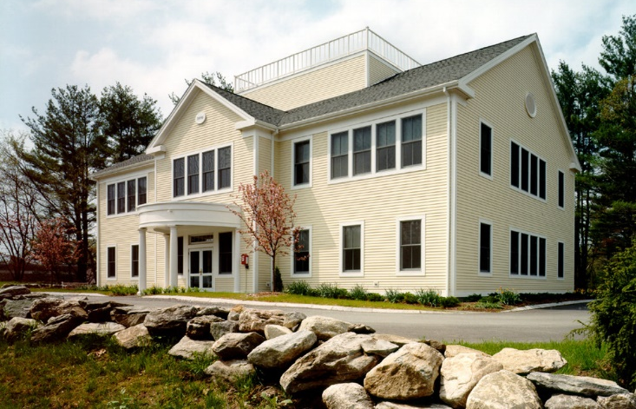
Community Needs Assessment
Summary of Key Findings and Recommendations
Cable Franchise/License Renewal

Slide 2
Review of License Renewal Process
Statutory Requirements
Starts 30-36 months before a current license expires
Requires license performance review of operators
Community needs assessment
Determine renewal goals and prepare draft license agreements
Must be based on needs assessment and past performance review
Conduct an Informal Process -- Negotiations
Negotiations can take a year or more
If negotiations reach an impasse, move forward with the issuance of a RFP

Slide 3
Carlisle Cable Facts
Comcast’s 10-year license expires in October 2021 (will likely be extended 1 year to complete negotiations)
Comcast has about 1,354 subscribers in Carlisle
Recent Town data: about 1,876 housing units in Carlisle
Total number of homes passed: unknown, but over 1,354
Comcast’s license is beneficial to Carlisle because it supports public, educational, and government (PEG) access programming, currently including:
Three channels for PEG access programming
(continued on next slide)

Slide 4
Carlisle Cable Facts
Comcast license currently includes (continued):
PEG access/community media funding support
Capital grant (one time): $90,000
Annual funding: 4.8% of gross cable TV revenues
Ability to deliver programming to cable TV subscribers from Town Hall and the PEG access studio that is now located at the Concord-Carlisle Regional High School
Free cable TV connections to the Town, schools, and community locations
All of these community benefits are on the table during the license renewal process

Slide 5
Carlisle Cable Facts:
The Carlisle cable TV license agreement is very valuable to Comcast
Conservative estimate of Comcast’s cable TV revenues from its license agreement (excluding Internet and telephone service revenues):
1,400 subscribers x $125 per month/per subscriber x 12 months x 10 years = $21,000,000
Comcast can leverage its cable TV license to triple those earnings in Internet & telephone service revenues

Slide 6
Needs Assessment Process
Needs Assessment activities to identify a broad scope of cable-related community needs & interests included:
Two Zoom focus group workshops (April 6 - 8)
31 different participants
Online community survey (April 6 - May 31)
120 completed surveys
22 different community groups, public agencies, educational institutions & businesses were represented by participants in the focus groups and online survey
Input from the Select Board and the public (January 5)
Public Hearing at City Hall (September 14)

Slide 7
Needs Assessment Process
Needs Assessment activities also included these PEG access-related tasks:
Evaluation of current PEG access equipment, facilities, and services
Identify and recommend upgrades to facilities and services
Several meetings (Zoom and in-person) with interested community members regarding PEG access
All information gathered during the Needs Assessment was included in our report that documented the findings and made recommendations.

Slide 8
Key Findings of Needs Assessment
Online Survey
About 69% of respondents subscribe to Comcast, and 77% of them pay more to get high definition channels.
Of those who get HD channels, 62% said they rarely or never watch channels not delivered in HD.
55% of subscribers said they most often use the on-screen guide to find programming information, over three times as many as the next most popular method.

Slide 9
Key Customer Service Findings of Needs Assessment
Online Survey
47% of all subscribers said they were satisfied with Comcast overall; 38% said they were dissatisfied.
73% gave “Very Good” or “Good” ratings to Comcast’s reliability and the quality of the picture and sound.
Areas most often rated “Poor” or “Very Poor” –
Rates charged for cable service (72%)
Ability to quickly speak to a customer service representative when you call (35%)
63% of subscribers tried to contact Comcast by phone in the past year. 76% of them said waited one minute or more or were never connected.

Slide 10
Key PEG Access Findings of
Needs Assessment
Online Survey
All respondents were asked to indicate their interest in several types of local programs and services. Here are the ones that were of most interest:
Carlisle news and information (54%)
Government/public agency meetings (50.5%)
Community bulletin board (50%)
Live coverage of local events (46%)
Informational programs about services & activities of Carlisle organizations and clubs (45%)

Slide 11
Discussion Summary of Meeting with Community Leaders
Issues raised at January 5, 2021 Selectmen Meeting
Cable service isn’t available in all areas of Carlisle
Cable lying on the ground
Poor customer service
Need to have PEG access channels in HD
Issues raised during meetings regarding PEG access
Need for PEG equipment to be located in Carlisle
Need PEG staff person in Carlisle to serve Carlisle
Lack of Carlisle-centric programs on access channel

Slide 12
Review and Inspection
PEG Facilities, Services, Equipment
Minuteman Media Network (Town of Concord-Division of Public Information) manages a PEG access facility at the Concord Carlisle High School, which is shared by Concord and Carlisle
Town of Concord has a PEG Access Advisory Committee to monitor PEG channels
One Carlisle resident is an ex-officio member (not voting)
Inter-Municipal Agreement between Concord and Carlisle details relationship regarding PEG facilities and equipment

Slide 13
Review and Inspection
PEG Facilities, Services, Equipment Review
Concord and Carlisle share three PEG access channels
Carlisle franchise specifies 3 PEG access channels for Carlisle, NOT 3 shared channels
Production and playback equipment is HD ready.
Comcast does NOT provide HD channels for PEG access.
Comcast delivers the PEG access channels to Carlisle subscribers in the lower quality SD format.
On-line survey respondents, focus group participants, and public meeting participants raised concerns about the SD delivery of PEG programming by Comcast.

Slide 14
Review and Inspection
PEG Facilities, Services, Equipment Review
Minuteman Media Network (MMN) facility in Concord is small and not available to the community in evenings or on weekends.
There is no PEG equipment located in Carlisle except for fixed equipment in the Selectmen Meeting Room.
Information provided by MMN did not include the age of production equipment.
During an on-site visit in August 2021, MMN staff indicated that much of the equipment was 5 years old or older.
Equipment in the Carlisle Selectmen Meeting Room is HD-ready.

Slide 15
Key Findings of Needs Assessment
PEG Facilities, Services, Equipment Review
Items of concern expressed by on-line survey, focus group, and community meeting participants included:
Need for PEG access channels to be in HD.
Need for PEG equipment in Carlisle, in addition to the equipment in the Selectmen Meeting Room. The following equipment packages were suggested:
Robotic systems for meeting and event coverage located at Gleason Public Library (Hollis Room) and at the public school campus (auditorium).
Portable equipment and an editing system should be located in Carlisle.

Slide 16
Key Findings of Needs Assessment
PEG Facilities, Services, Equipment Review
Items of concern expressed by on-line survey, focus group, and community meeting participants also included:
Strong desire for more and higher quality Carlisle community programming to be available.
Desire for training classes.
Need a staff person to be assigned and located in Carlisle to develop programs and assist community members with program and event coverage.

Slide 17
Primary Recommendations
Cable Plant & Headend
The Comcast cable system should include features typically found in state-of-the-art systems throughout the license term, and be upgraded as needed.
Comcast should make service available to all areas of Carlisle
An updated line-extension policy is needed in the renewal license agreement
Comcast should provide sufficient capacity and other accommodations to ensure:
Carlisle PEG channel signal quality and functionality is equivalent to the highest quality channel offered on the cable system

Slide 18
Primary Recommendations
Cable Plant & Headend
Comcast should also provide sufficient capacity and other accommodations to ensure:
Ability to transmit live local programming from locations throughout Carlisle
Delivery of programming with closed captions (including Carlisle local programs)
Inclusion of complete Carlisle PEG access local program listings on Comcast’s on-screen electronic program guide

Slide 19
Primary Recommendations
Subscriber Service & Customer Satisfaction
Comcast should be strongly encouraged to offer less expensive programming packages. Rates charged for cable TV service received the highest negative response from subscribers.
Customer service standards should be updated and include the ability to promptly talk to a customer service representative and have them solve the vast majority of problems.

Slide 20
Primary Recommendations
Public, Education, Government Access
Comcast should be required to:
Maintain the current number of PEG access channels for Carlisle.
Convert all PEG access channels to HD
Provide the ability to originate live programming from the PEG Access facility (located at Concord-Carlisle High School), Carlisle Town Hall, Gleason Public Library, and Carlisle Public School.
Provide funding for access equipment and periodic replacement of equipment.

Slide 21
Primary Recommendations
Public, Education, Government Access
The Comcast franchise fees (used for PEG access support payments) should be increased from 4.8% to 5% of gross cable TV revenues.
All Carlisle PEG access channels and complete PEG access local program listings should appear on Comcast’s on-screen electronic program guide.

Slide 22
Next Steps
License Renewal
Proceed with negotiations consistent with public input, legal obligations, and findings and recommendations.
Negotiate a renewal License to meet the communication needs and interests of Carlisle residents and businesses through 2032!

