Slide 1
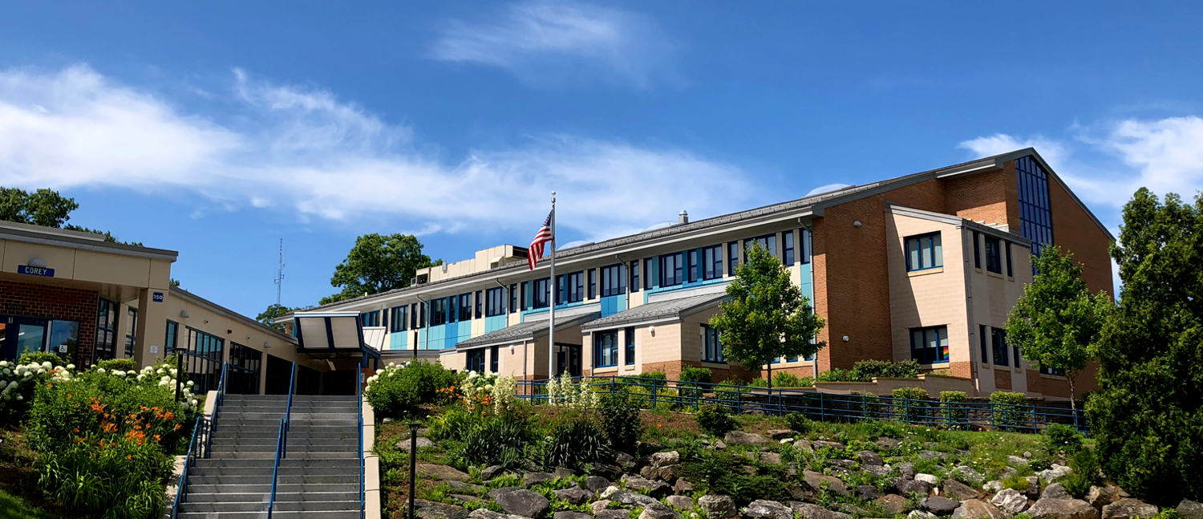
Carlisle Public School
Finance Committee 1/10/23

Slide 2
Recent Budgetary Context
At the end of FY20
CPS returned approximately $213k to the Town
Prepared a level funded budget for FY21
At the end of FY21
CPS returned approximately $120k to the Town
Prepared an FY22 budget with a 4.3% increase over FY21
By utilizing ESSER funds moving from a 5.1% increase to a 4.3% increase
FY22
No balance at end of FY22
School was able to cover closing costs from EDCO
Covered the installation of water treatment system
Paid the late Ameresco bill for power credits
Negotiated a new 3 year contract with CTA (FY24 contains 2.5% salary increase)
Increased K fees for FY23
The town received a rebate from CASE Collaborative based upon over payment of $31K
Developed an FY23 budget with a 3.07% increase
Continue to work towards a CAGR of under 3%
FY23
Developed an initial FY24 budget proposal with a 3.02% increase
Maintained a 10 year CAGR of 2.48%
Increased K fees for FY24
Funding for Phone System and Grant Elevator not included in budget, though a priority.

Slide 3
Key Budget Drivers FY24
Personnel obligations and increases (steps, lanes, COLA, 6 lane changes so far 2022) account for a 5% increase in the budget. ($514,399) Salaries make up 82% of budget. ($11,131,010)
Decrease in Federal grant funding ($79K)
Increase in State grant funding ($47K)
Reduced supply budget by $40K (Math Curriculum)
Increased student fees by approximately $50K over 2 years (FY23 and FY24)
Increases in transportation costs, second year extension plus estimated fuel adjustment clause ($56K Reg, $25K SPED)
A 20% Decrease in Out Of District tuitions (Approximately $100K).
Other considerations, needs and requests.
Note for FY25 all ESSER Grant Funding will be gone

Slide 4
Considerations for FY24 Budget
Additional Tier II Tutor for Elementary- $37K
To address necessary support for skill development and differentiation
Requests included in FY24 budget proposal
Additional Tier II Tutor for Elementary- $37K

Slide 5
FY24 Budget Proposal
$12,794,097 = 3.02% increase over FY 23
Voted Budgets, (blue)
Year over Year % Increa,
(gold)
10 Year CAGR = 2.48%

Slide 6
CPS YOY Budget Detail

Slide 7
CPS FY24 Select Budget Items
CONTRACTUAL INCREASES | $477,400
NEW TIER II TUTOR | $37,000
TUITION & CONTINGENCY | ($178,041)
TRANSPORTATION REGULAR ED (5% + FUEL ADJUSTMENT) SPECIAL EDUCATION TOTAL TRANSPORTATION INCREASE | $81,659 $56K $25K $81,659
FY24 GRANTS | ($31,183)
STUDENT FEES INCREASE IN K FEES ACCUMULATED SPED TUITION ANNUAL ALLOCATION WITH ACCUMULATED REVOLVING FEES TOTAL STUDENT FEES | $91,209 $25K $22K $176K $223,840
Total Increase FY24 | $375,643 or a 3.02% increase

Slide 8
CPS Projected Student Enrollment
Grade | 2018-19 | 2019-20 | 2020-21 | 2021-2022 | 2022-23 | 2023-24
Pre-K | 14 | 14 | 15 | 15 | 12 | 15
K | 58 | 52 | 53 | 76 | 63 | 57-59
1 | 62 | 61 | 52 | 59 | 77 | 63-65
2 | 62 | 66 | 63 | 53 | 60 | 77-79
3 | 62 | 68 | 68 | 71 | 57 | 62-64
4 | 64 | 64 | 68 | 68 | 69 | 58-60
5 | 76 | 65 | 60 | 71 | 65 | 69-71
6 | 65 | 77 | 68 | 61 | 72 | 66-68
7 | 73 | 66 | 79 | 67 | 62 | 72-74
8 | 73 | 73 | 67 | 82 | 69 | 63-65
Total | 609 | 606 | 593 | 623 | 606 | 602-620

Slide 9
CPS Projected Sections
Grade | Actual Grade Sizes 22-23 | Actual Sections 22-23 | Average Class sizes 22-23 | Projected Class Size 2023-2024 | Projected Class Sections 2023-2024 | Average Class sizes 2023-2024
Pre-K | 13 | 1 | 13 | 15 | 1 | 15
Kindergarten | 63 | 4 | 16 | 57-59 | 4 | 15
First | 77 | 5 | 16 | 63-65 | 4 | 16
Second | 60 | 3 | 20 | 77-79 | 5 | 16
Pre-K - 2 | 203 | 12 | 17 | 212-218 | 14 | Guideline<18
Third | 57 | 3 | 19 | 62-64 | 3 | 21
Fourth | 69 | 4 | 17 | 58-60 | 3 | 18
Fifth | 65 | 4 | 17 | 59-71 | 4 | 17
3 - 5 | 210 | 12 |  | 179-195 | 10 | Guideline<21
Sixth | 72 | 4 | 18 | 66-68 | 4 | 17
Seventh | 62 | 4 | 16 | 72-74 | 4 | 18
Eighth | 69 | 4 | 17 | 63-65 | 4 | 16
6 - 8 | 210 | 12 |  | 201-207 | 12
Total (Pre-K-8) | 623 | 36 | 17 | 602-620 | 36
Total sections |  | 36 |  |  | 36

Slide 10
CPS Projected Staffing
 | Staffing FY23 FTEs | Projected Staffing FY24
Department
Regular Education | 48.4 | 48.4
Special Education | 18.4 | 18.4
Student Services | 5 | 5
Administration | 7 | 7
Admin Support | 6 | 6
Educational Support | 28 | 29
Facilities | 7 | 7
Cafeteria | 5 | 5
Recess Support | 2 | 2

Slide 11
District Comparison
COMMUNITY | Carlisle FY21 (K-8) | Bedford FY21 (K-12) | Concord FY21 (K-8) | Dover FY21 (K-6) | Harvard FY21 (K-12) | Lincoln FY21 (K-8) | Sherborn FY21 (K-6) | Sudbury FY21 (K-8)
Students | 598 | 2673 | 2038 | 493 | 1059 | 1115 | 397 | 2580
General Fund | $11,956,431 | $51,284,355 | $44,320,274 | $12,139,916 | $17,810,933 | $14,341,394 | $7,920,816 | $48,366,911
Grants, Revolving & Other $ | $858,746 | $5,838,471 | $3,097,138 | $595,032 | $4,426,023 | $17,096,789 | $654,118 | $3,124,559
Total $ | $12,815,177 | $57,122,825 | $47,417,412 | $12,734,948 | $22,236,956 | $31,438,183 | $8,574,934 | $51,491,470
PerPupil Cost | $21,430.06 | $21,372.70 | $23,268.92 | $25,842.02 | $21,006.00 | $28,188.10 | $21,626.57 | $19,954.84
Administrative & Instructional Leadership | 6.89% | 9.16% | 9.41% | 10.20% | 8.41% | 12.42% | 10.63% | 11,72%
Direct Service to Students | 74.04% | 62.53% | 65.92% | 46.93% | 58.15% | 58.15% | 61.32% | 63.62%
Total SPED OOD Expenses | 5.10% | 9.19% | 5.70% | 19.49% | 9.75% | 7.99% | 6.24% | 3.26%

