Slide 1
Article 31, Davis Land CR
The State is purchasing a 23-acre lot on East Street (26-2-0) from the Davis family for addition to abutting Great Brook Farm State Park.
The lot currently has a Conservation Restriction (#11) granted to the Town in 1978 by Jim and Wendy Davis. The CR prevents development of the land.
The State cannot purchase land with a CR held by a Town.
This article will transfer CR ownership from the Town to the State so the sale can proceed.
Transfer of the CR has been unanimously recommended by the Conservation Commission, Conservation Restriction Advisory Committee, and Trails Committee.
The land transfer will provide public access to part of the Tophet East Trail, which follows historic Old Babson Road. The current CR does not include public access to the trail.

Slide 2
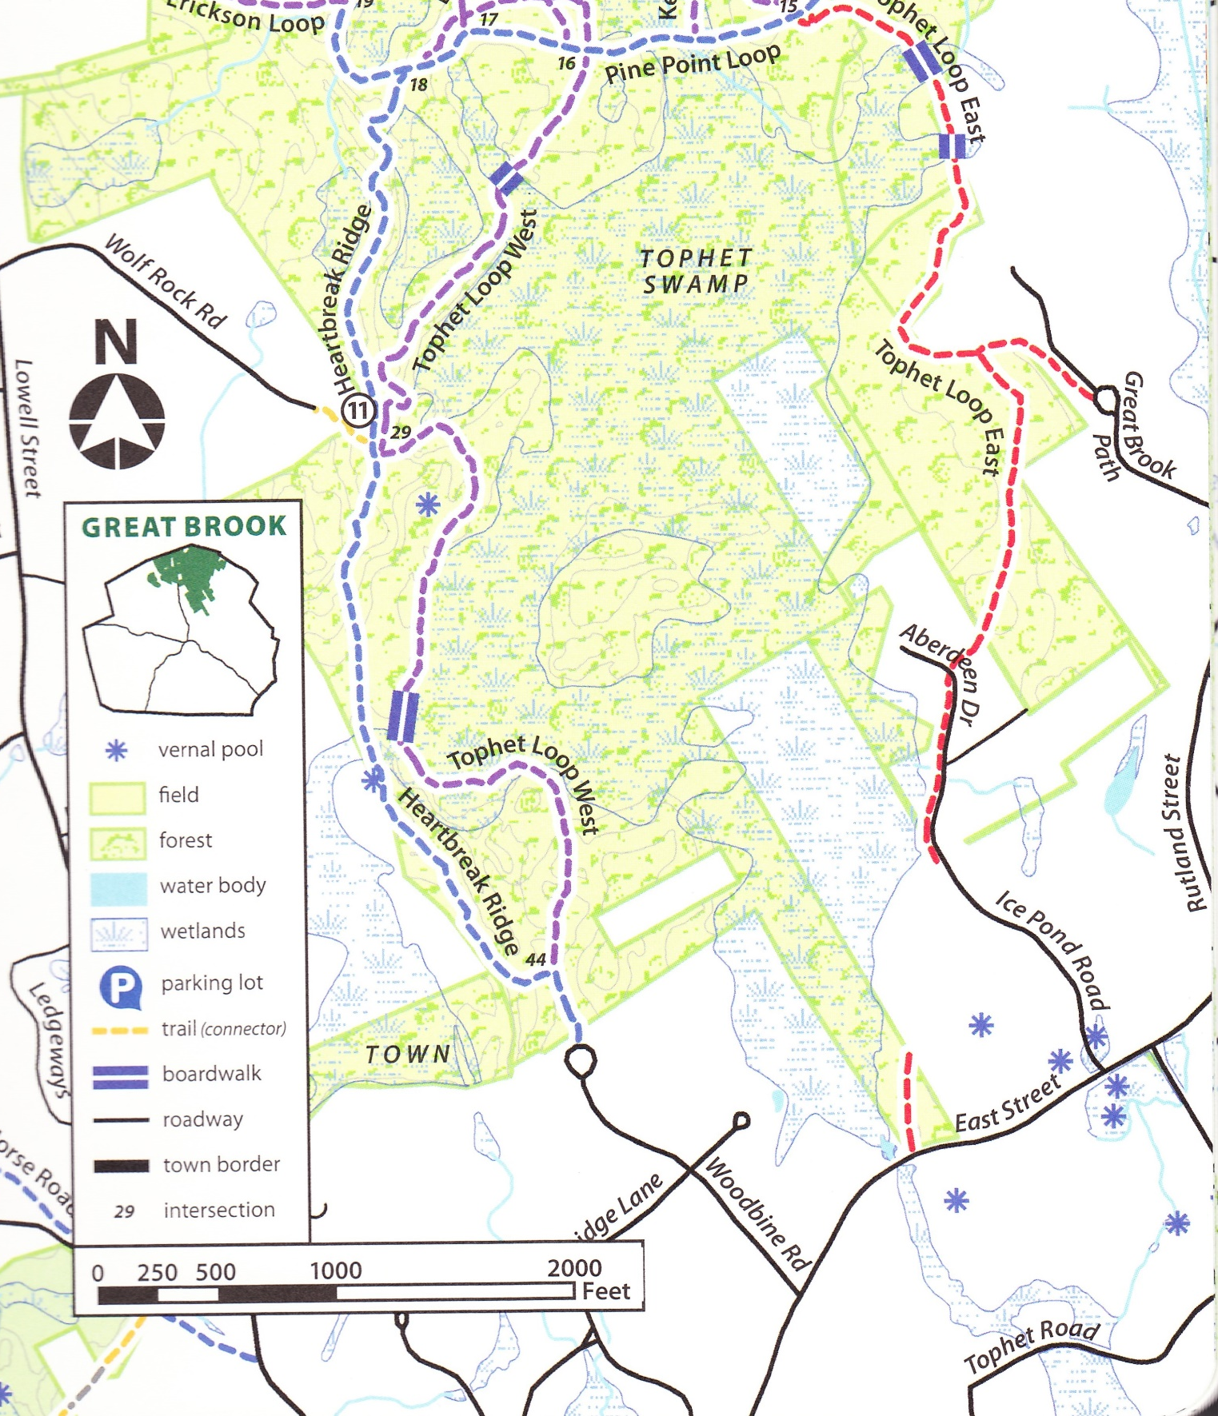
Tophet East Tr
Davis Lot

Slide 3
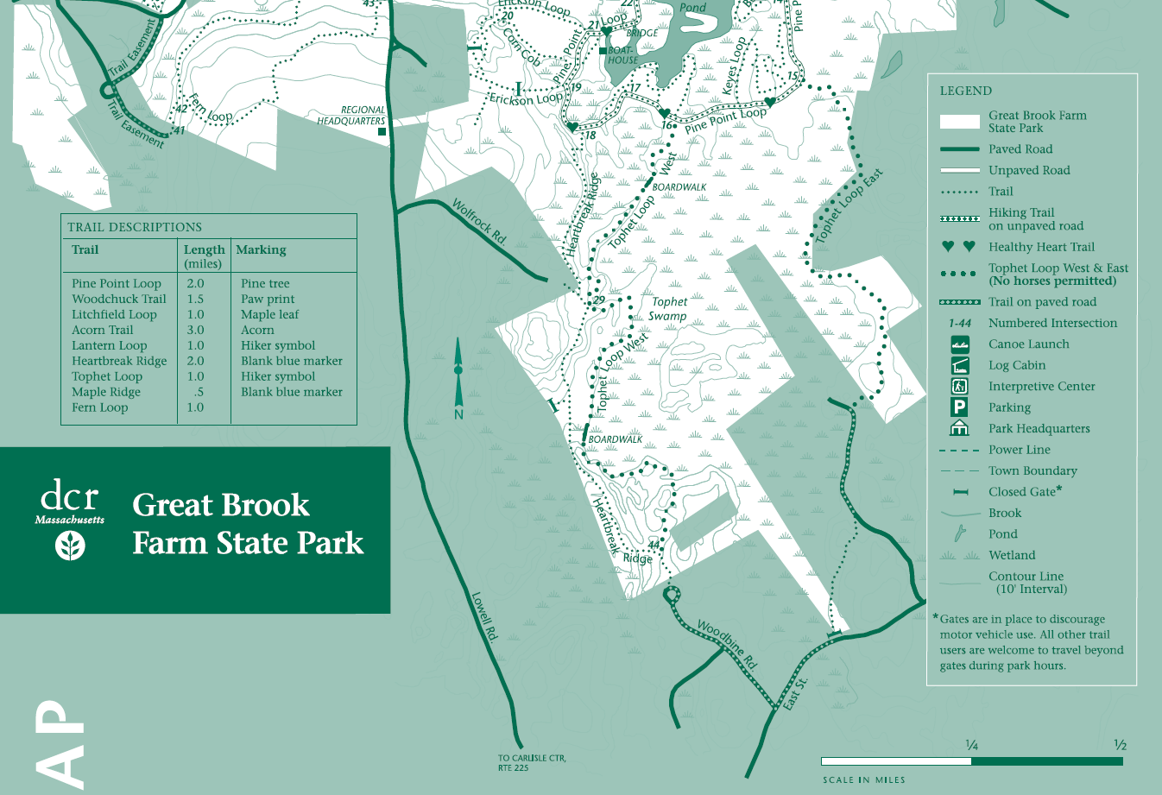
Davis
Ice Pond Rd
The section of the Tophet East Trail through the Davis property does not currently have public access

Slide 4
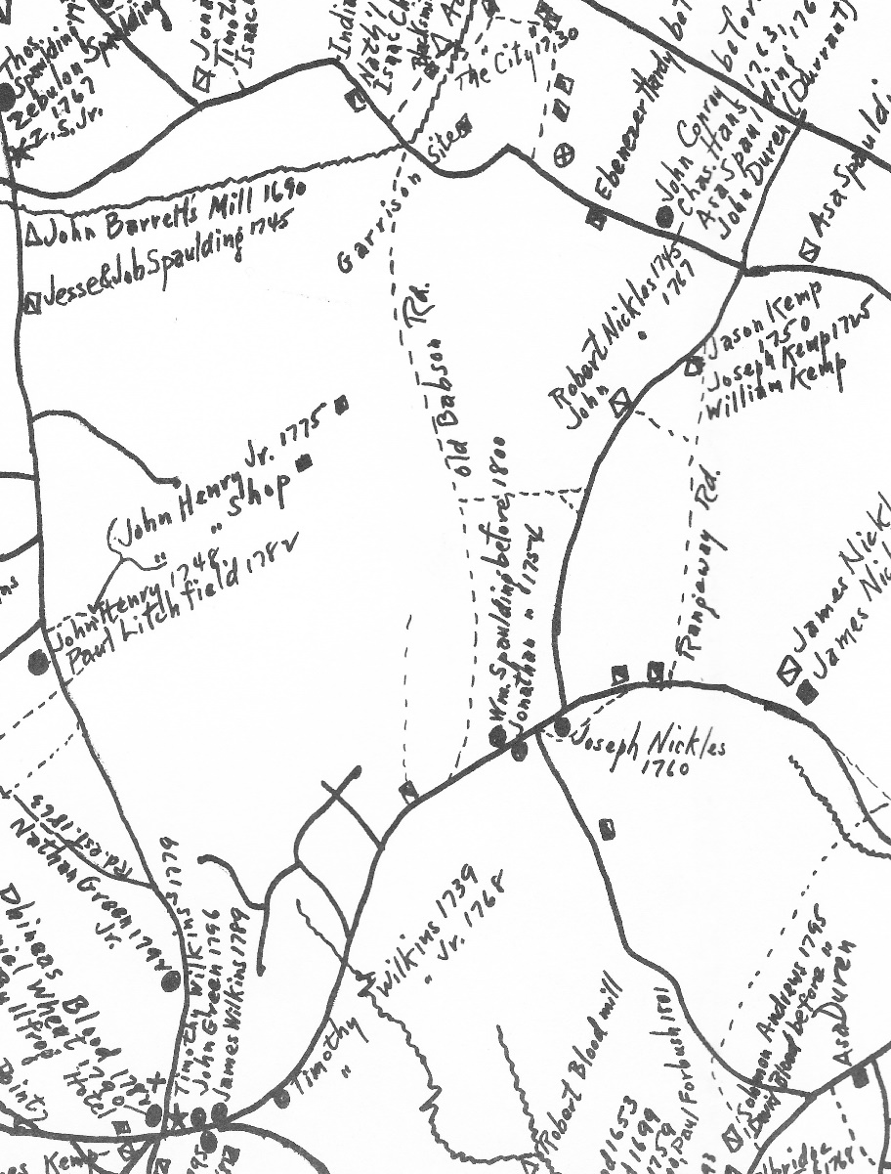


Historical Map from Carlisle, Composite Community by Donald Lapham (1974)
Highlighting the route of Old Babson Road.
The portion of the Tophet East Trail in the Davis CR follows Old Babson Road.
Rangeway Rd
469
East St
East Riding Dr

Slide 5
Pros:
Adding the Davis lot to the State Park will fill a gap in public access to the Tophet East Trail. This has been a long-term goal of the Carlisle Trails Committee and the State Park.
The land will continue to be protected from development.
It will be one less CR property for the Conservation Restriction Advisory Committee to monitor.
The Town will receive some annual income from the State as Payment in Lieu of Taxes.
Cons:
1. The Town will lose annual property taxes on the parcel, $2,284.

