Slide 1

Town of Carlisle FY26 Budget Review Finance Committee May 18, 2025

Slide 2
FY2026 Budget Summary
FY26 Operating Budget of $36,861,687 (increase of 4.87% from FY25)
* Excludes warrant and capital proposed expenditures
Average tax bill increase of 3.46%
Estimated excess levy capacity of $3,456,995 (9.4%)
Reserves at 12.40% of Operating Budget

Slide 3
FY2026 Budget Process
Sept – Dec Dec - March March - April
Budget Kickoff
Budget Guidelines
Finalize
Budget
Set budget goals with Select Board and FinCom
Conducted 2-day budget marathon presentations with Town Departments
Met multiple times with Concord Carlisle Regional School District and Concord Finance Committee, as well as Concord FinCom
24 Finance Committee meetings; 2 joint meetings with Select Board
2% Cut exercise with each department
Public Hearing 8th May 2025

Slide 4
FY2026 Sources of Revenue
Source | $ FY 2026 | % of Revenue
Property Taxes | $33,058,175 | 89.3%
State Aid | $2,093,697 | 5.7%
Local Receipts | $1,607,491 | 4.3%
Free Cash | $250,000 | 0.07%
Total: | $37,009,363 | 100.0%
Notes:
\

Slide 5
Average Tax Single Family Home FY2026 Increase 3.46% to $17,428 (+ $599 per Home)

Slide 6
Tow Reserve Analysis
Current Reserves
Free Cash $ 4,872,786
Stabilization Fund $ 1,326,069
Total $ 6,198,855
Total as % of Budget 16.82%
Reserves After Proposed Uses in FY26
Free Cash $ 3,244,286
Stabilization Fund $ 1,326,069
Total $ 4,570,355
Total as % of Budget 12.40%

Slide 7
FY2026 Town Expense Summary
Category | Dollar Amount | % of Expenses
Education (CPS, CCRSD w/debt & Vocational Services | $22,147,015 | 54.12%
Town Departments | $8,871,914 | 21.68%
Insurance, Benefits, & Retirement (Other post-employment benefit Trust “OPEB”) | $4,487,758 | 10.97%
Debt Service and Reserve | $1,205,000 | 2.94%
Reserve Fund | $150,000 | 0.37%
Total: | $36,861,687

Slide 8
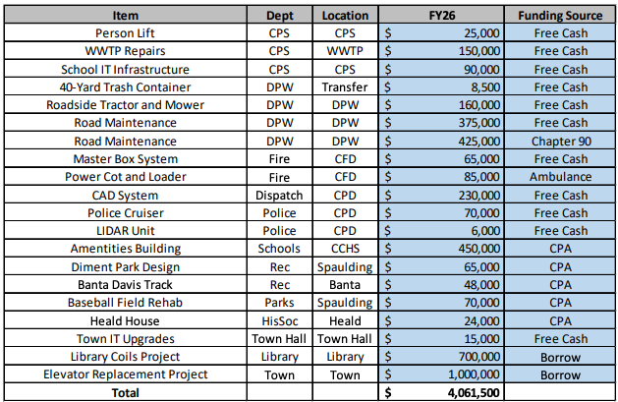
FY2026 Capital Plan Overview

Slide 9
FY2026 Education Review
Total Education Expense $22,147,015 FY26 increase $741,974 (+3.46%)
Carlisle Public School Total: $13,733,211 (+3.90%)
CCRSD Total: $7,433,454 (+4.06%) w/o debt service
Vocational Total: $93,451 (-22.91%)

Slide 10
Carlisle Public School Budget
FY26 Budget = $13,733,211 (+3.9%)
10 Year Average= 2.78%
Notes:
Slide 10 lable axis for red line and change 10 year CAGR to 10 yr average; call out 21 was a covid year

Slide 11
Carlisle / CCRSD Assessment (w/o Debt)
Carlisle & Concord Combined = $31,250,675
FY26 Increase = 3.15% (w/ debt)
10 Year Average = 3.27%
Notes:
Combine with slide 11 (remove red line)

Slide 12
FY2026 - Conclusion
Level service budget, with key drivers outside of our control
2% decrease would impact services on town
Large capital projects on horizon (Police Station, DPW, Fire House)
Education costs escalation management
Ongoing backlog of material capital maintenance
Managing expense containment while maintaining level services, reorganization, resource sharing, centralization or outsourcing options
Working with departments to establish 5-year budget projections

