Slide 1

Town of Carlisle Article 2 FY26 Capital Equipment

Slide 2
FY2026 Capital Plan Process
Departments submitted capital requests as part of the FY26 budget process
FinCom met with each department to review department capital requests. Select Board also reviewed capital requests as part of the budget process.
FinCom confirmed all capital requests were in alignment with the five-year Capital Plan as outlined in the Carlisle Budget Book
Notes:
Process cut doen (transparency – open to all to attend; review new collaboration with FInCom and the CCSRD SC

Slide 3
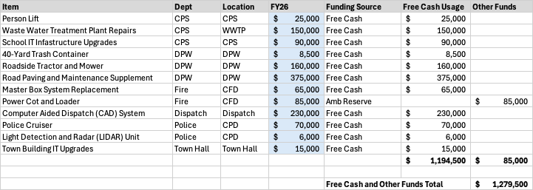
FY2026 Capital Equipment Plan

