Slide 1
CPA Article 22
Community Preservation Committee (CPC)
Affordable Housing Trust
Chris Johnson-Batista
Conservation Commission
Helen Young
Historic Commission
Krissy O’Shea
Member at-large
Maureen Cosgrove- Deery
Planning Board
Addie Grady
Recreation Commission
Courtney Bittelari
Select Board
Barney Arnold
CPC Chair
1

Slide 2
How CPA Works
Annual 2% surcharge on
  property tax bill
FY25: 16% state match of local CPA $
CPC manages funding cycle & grants
CPC recommends projects to TM
Eligible Categories
* Historic Preservation
* Conservation & Outdoor Recreation
* Community Housing
(affordable)

Slide 3
Motion 1
FY26 Recommended Allocation of Funds
$75,000 Historic Preservation
$75,000 Open Space/Outdoor Recreation
$75,000 Community (affordable) Housing
$35,000 CPC Administrative Account

Slide 4
CPC recommendations for FY26 CPA Projects
 | ** indicates this motion will be part of the consent agenda | ** CONSENT AGENDA | Project Total |  | Undesignated | Historic Preservation | Open Space & Outdoor Recreation | Community Housing |  | Total
FY26 FUND BALANCES |  |  |  |  | 2,356,155.91 | 139,456.58 | 95,409.00 | 626,217.12 |  | 3,217,238.61
 | Motion 2** RENTAL ASSISTANCE FOR CARLISLE RESIDENTS |  | (50,000) |  |  |  |  | (50,000)
 | Motion 3** DIMENT PARK PHASE I |  | (65,000) |  |  |  | (65,000)
 | Motion 4** BANTA-DAVIS TRACK |  | (48,000) |  | (17,591) |  | (30,409)
 | Motion 5** SPALDING FIELD BASEBALL FIELD |  | (70,000) |  | (70,000)
 | Motion 6** HEALD HOUSE & BARN |  | (24,000) |  |  | (24,000)
 | Motion 7 CCHS AMENITIES BUILDING |  | (432,345) |  | (432,345)
 | TOTAL FY26 CPA PROJECTS |  | (689,345) |  | (519,936) | (24,000) | (95,409) | (50,000) |  | (689,345)
 | NEW FUND BALANCES |  |  |  | 1,836,219.91 | 115,456.58 | - | 576,217.12 |  | 2,527,893.61

Slide 5
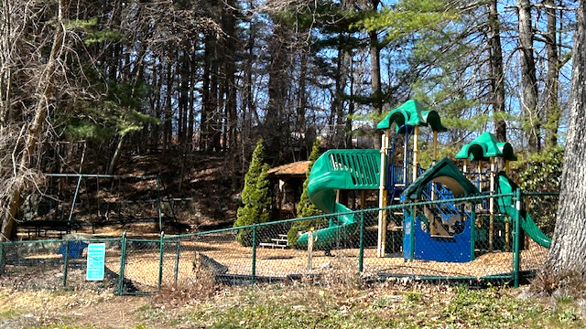
Diment Park Today

Slide 6
Diment Park Restoration
Goals
  Retain original intent to have a “Tot Lot”
  Safe & ADA Accessible
  Play Space - inclusive, open-ended design
  Low Maintenance

Slide 7
Motion 2
Diment Park Restoration Phase 1 $65,000
PHASE 1 Objectives *
Complete land survey
Hire designer
Prepare draft design
Community review
Construction bids
* Phase 2 Future Construction Sources TBD
* Phase 3 Rec Com Assumes Responsibility

Slide 8
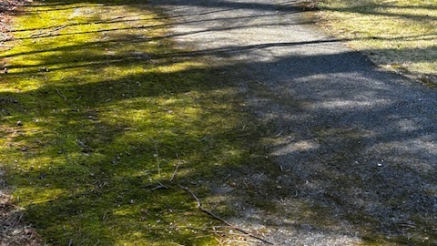
Banta-Davis Track Today

Slide 9
Motion 3
Banta Davis Track Renovation $68,000
Reclaim + repave existing track
Make safe for recreation + track meets
Add 4 additional parking spots;
2 accessible
Pave accessible path - parking lot to field
Pave aprons
along track for spectators
Add fixed benches; space for wheelchairs
Repair fences & gates

Slide 10
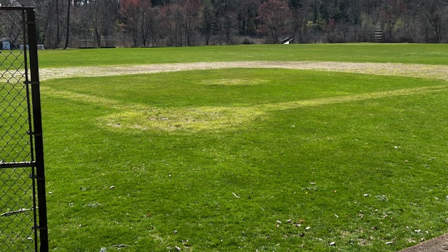
Baseball Field

Slide 11
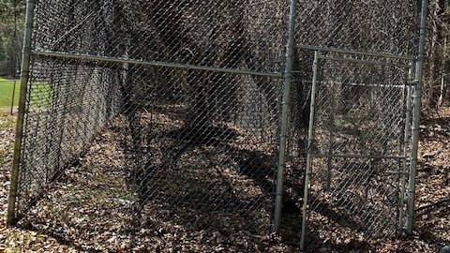
Feel like taking a few swings in this batting cage?

Slide 12
Motion 4
Spalding Field Baseball Field $70,000
Baseball Field & Batting Cage
Meet safety and baseball standards; upgrade irrigation system
Restore 60’ baseball field; new bases, foul poles, pitcher’s mound
Purchase portable backstop for Little League play
Adapt to 90’ field to allow adult play; repair permanent backstop
Repair batting cage structure, clear invasives & vegetation
Historic Restoration
Restore fieldstone retaining wall (1934 Civil Works Admin Project)

Slide 13
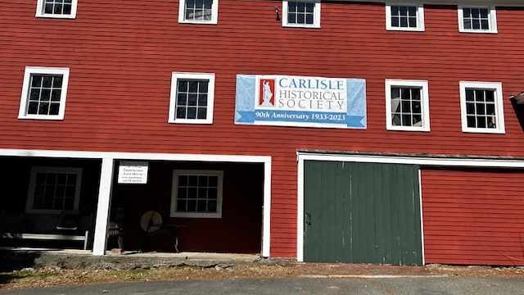
Heald House & Museum

Slide 14
Motion 5
Heald House Barn & Museum Restoration $24,000
  Major restoration of Heald House Barn & Museum completed with other funds
  Remaining to be done:
    Full exterior painting
    of museum
    Repair of barn cupola
    Exterior painting of
    barn facades

Slide 15
Motion 6 $50,000
Rental Assistance for Carlisle Residents (renewal)
Requirements & Benefits
income at/below 100% area median income
more than 30% of income spent on rent
no additional property valued over $50,000
maximum monthly assistance $400
low/moderate income renters able to live in Carlisle
Managed by Council on Aging & Human Services (COAHS)

