Slide 1

POLICE STATION RENOVATION PROJECT

Slide 2
Project History
MAY 18: Town Meeting to vote on additional, final project costs
MARCH TO MAY 2025: PSBRC recommends add alternate 1; OPM and committees recommend increased contingency value
JANUARY TO MARCH 2025: Construction bidding and review. Eight bids submitted, with the lowest bid by APC Development at $3,383,401, excluding alternates
SUMMER AND FALL 2024: Final Reviews by Town Committees and final construction set created, including list of add alternates. Owner’s Project Manager (OPM) RFP issued, candidates interviewed, and final selection of CMS
MAY 2024: Town Meeting and vote approved total project estimate at $3.55 million
2019: Renovation documents prepared, but project is tabled
1987: Police Station constructed

Slide 3
Financial Considerations
Carlisle residents are asked to support this project with two votes:
1. Annual Town Meeting Article # 18
2. Town Election Ballot Question # 1
The total project cost is $4,244,532, including a contingency value of $454,771. The Town will borrow to pay for this project.
To the extend contingency funds are not used, those funds are not borrowed.
The cost of this borrowing to the average Carlisle household is approximately $177 per year, declining annually for the length of the loan (30-year projection).

Slide 4
Project Goals
Modernize the police station to meet accreditation goals, increase retention/recruitment efforts, and improve officer and resident safety
Increase gender parity by expanding female locker room space
Create a community room that connects the department with residents and provides a safe and usable town resource
Upgrade aging building systems to meet the Town’s financial and sustainability goals as identified in the Master Plan; new systems to require less energy to operate

Slide 5
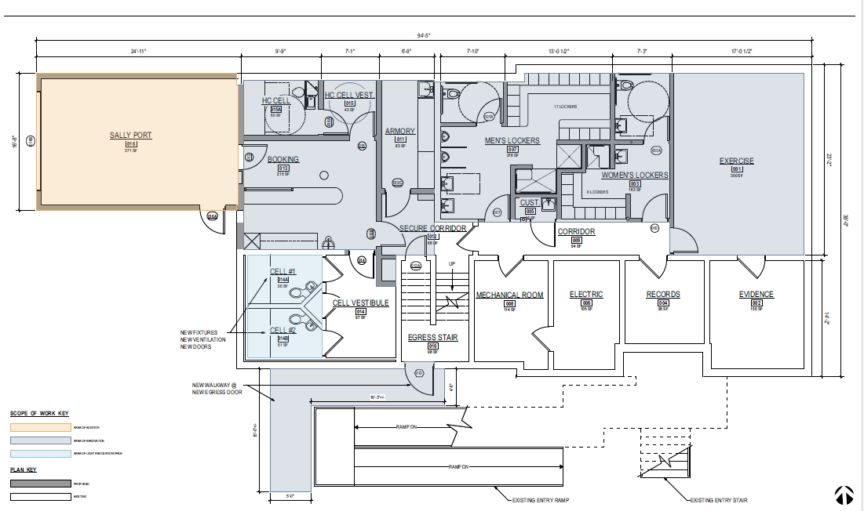
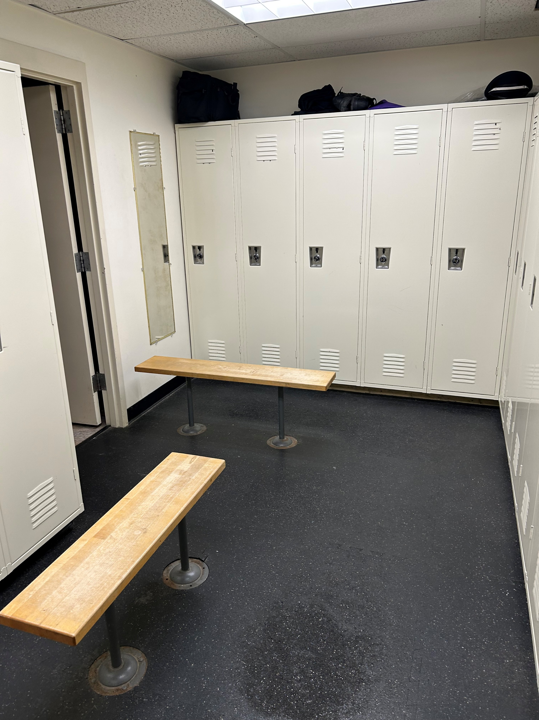
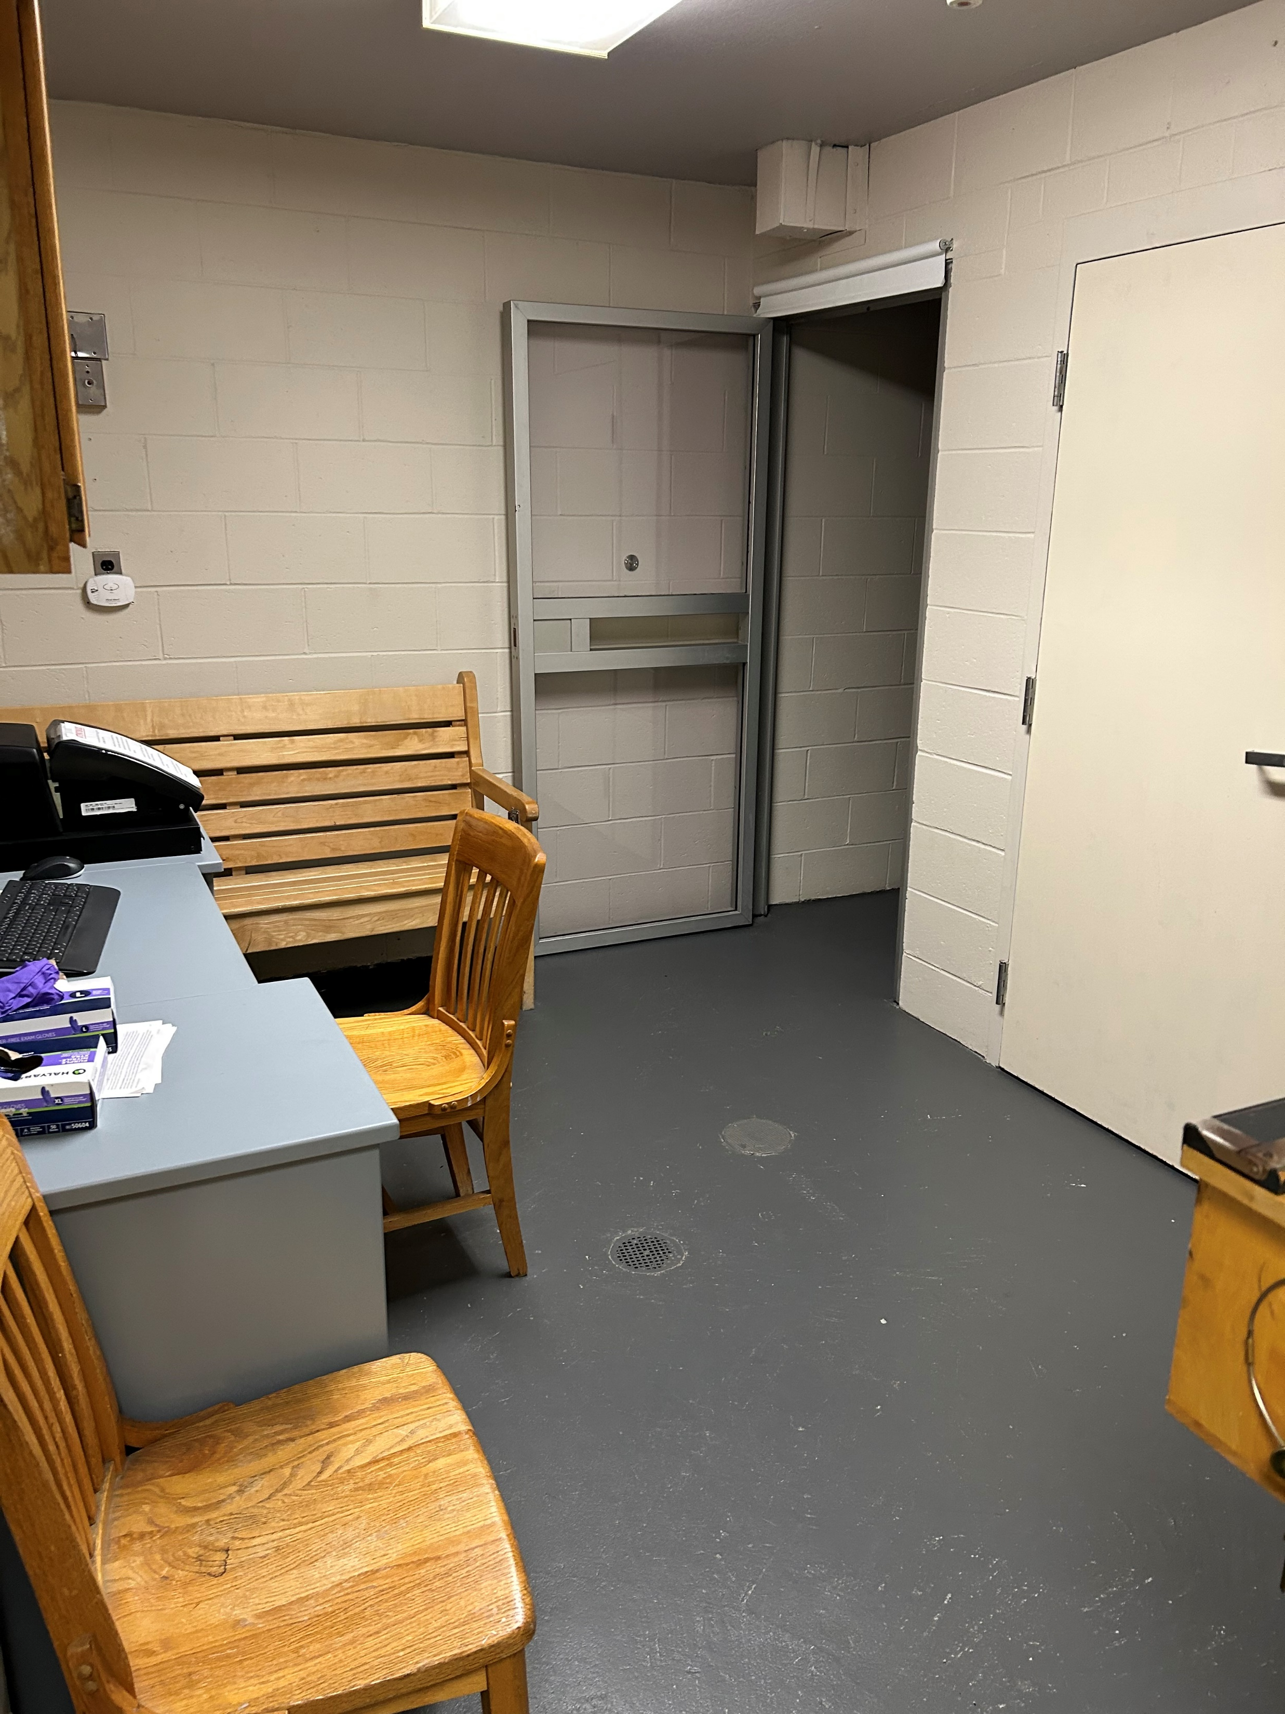
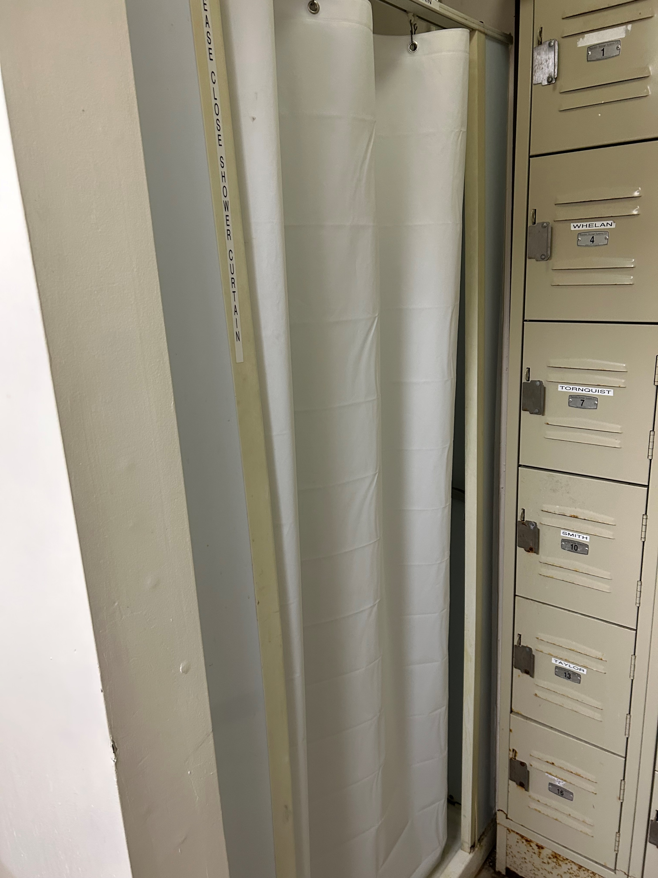
Ground Floor

Slide 6
Ground Floor
Creates a modernized, accessible, and safe booking room/holding cell area for processing prisoners
The proposed design complies with the Massachusetts Police Accreditation Commission
Will be code compliant with Department of Public Health, Town Building Codes, and Sustainability best practices
Increases gender parity by creating more space for female officers

Slide 7
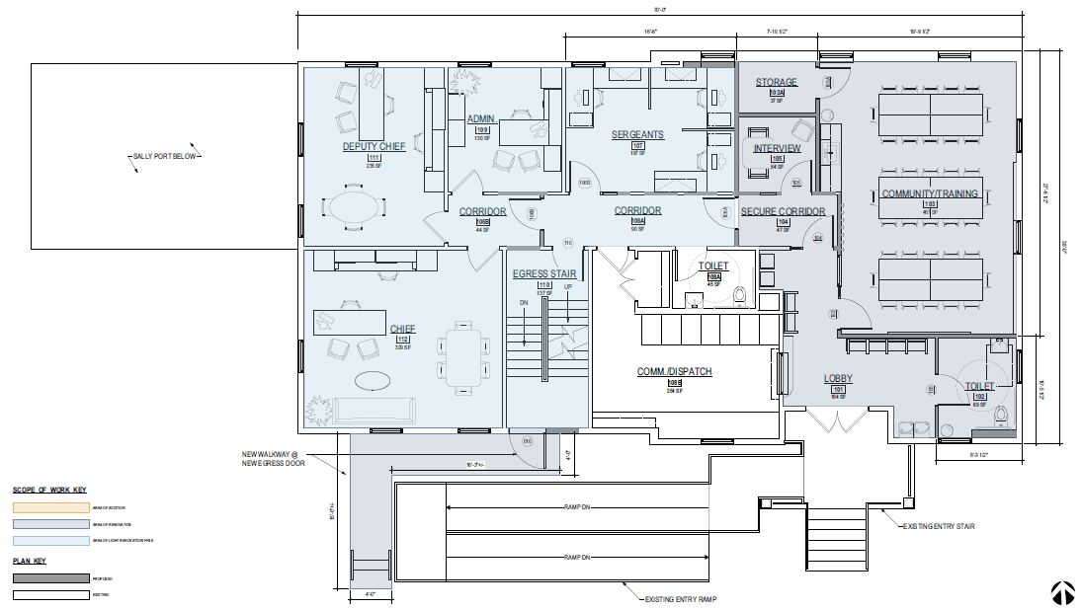
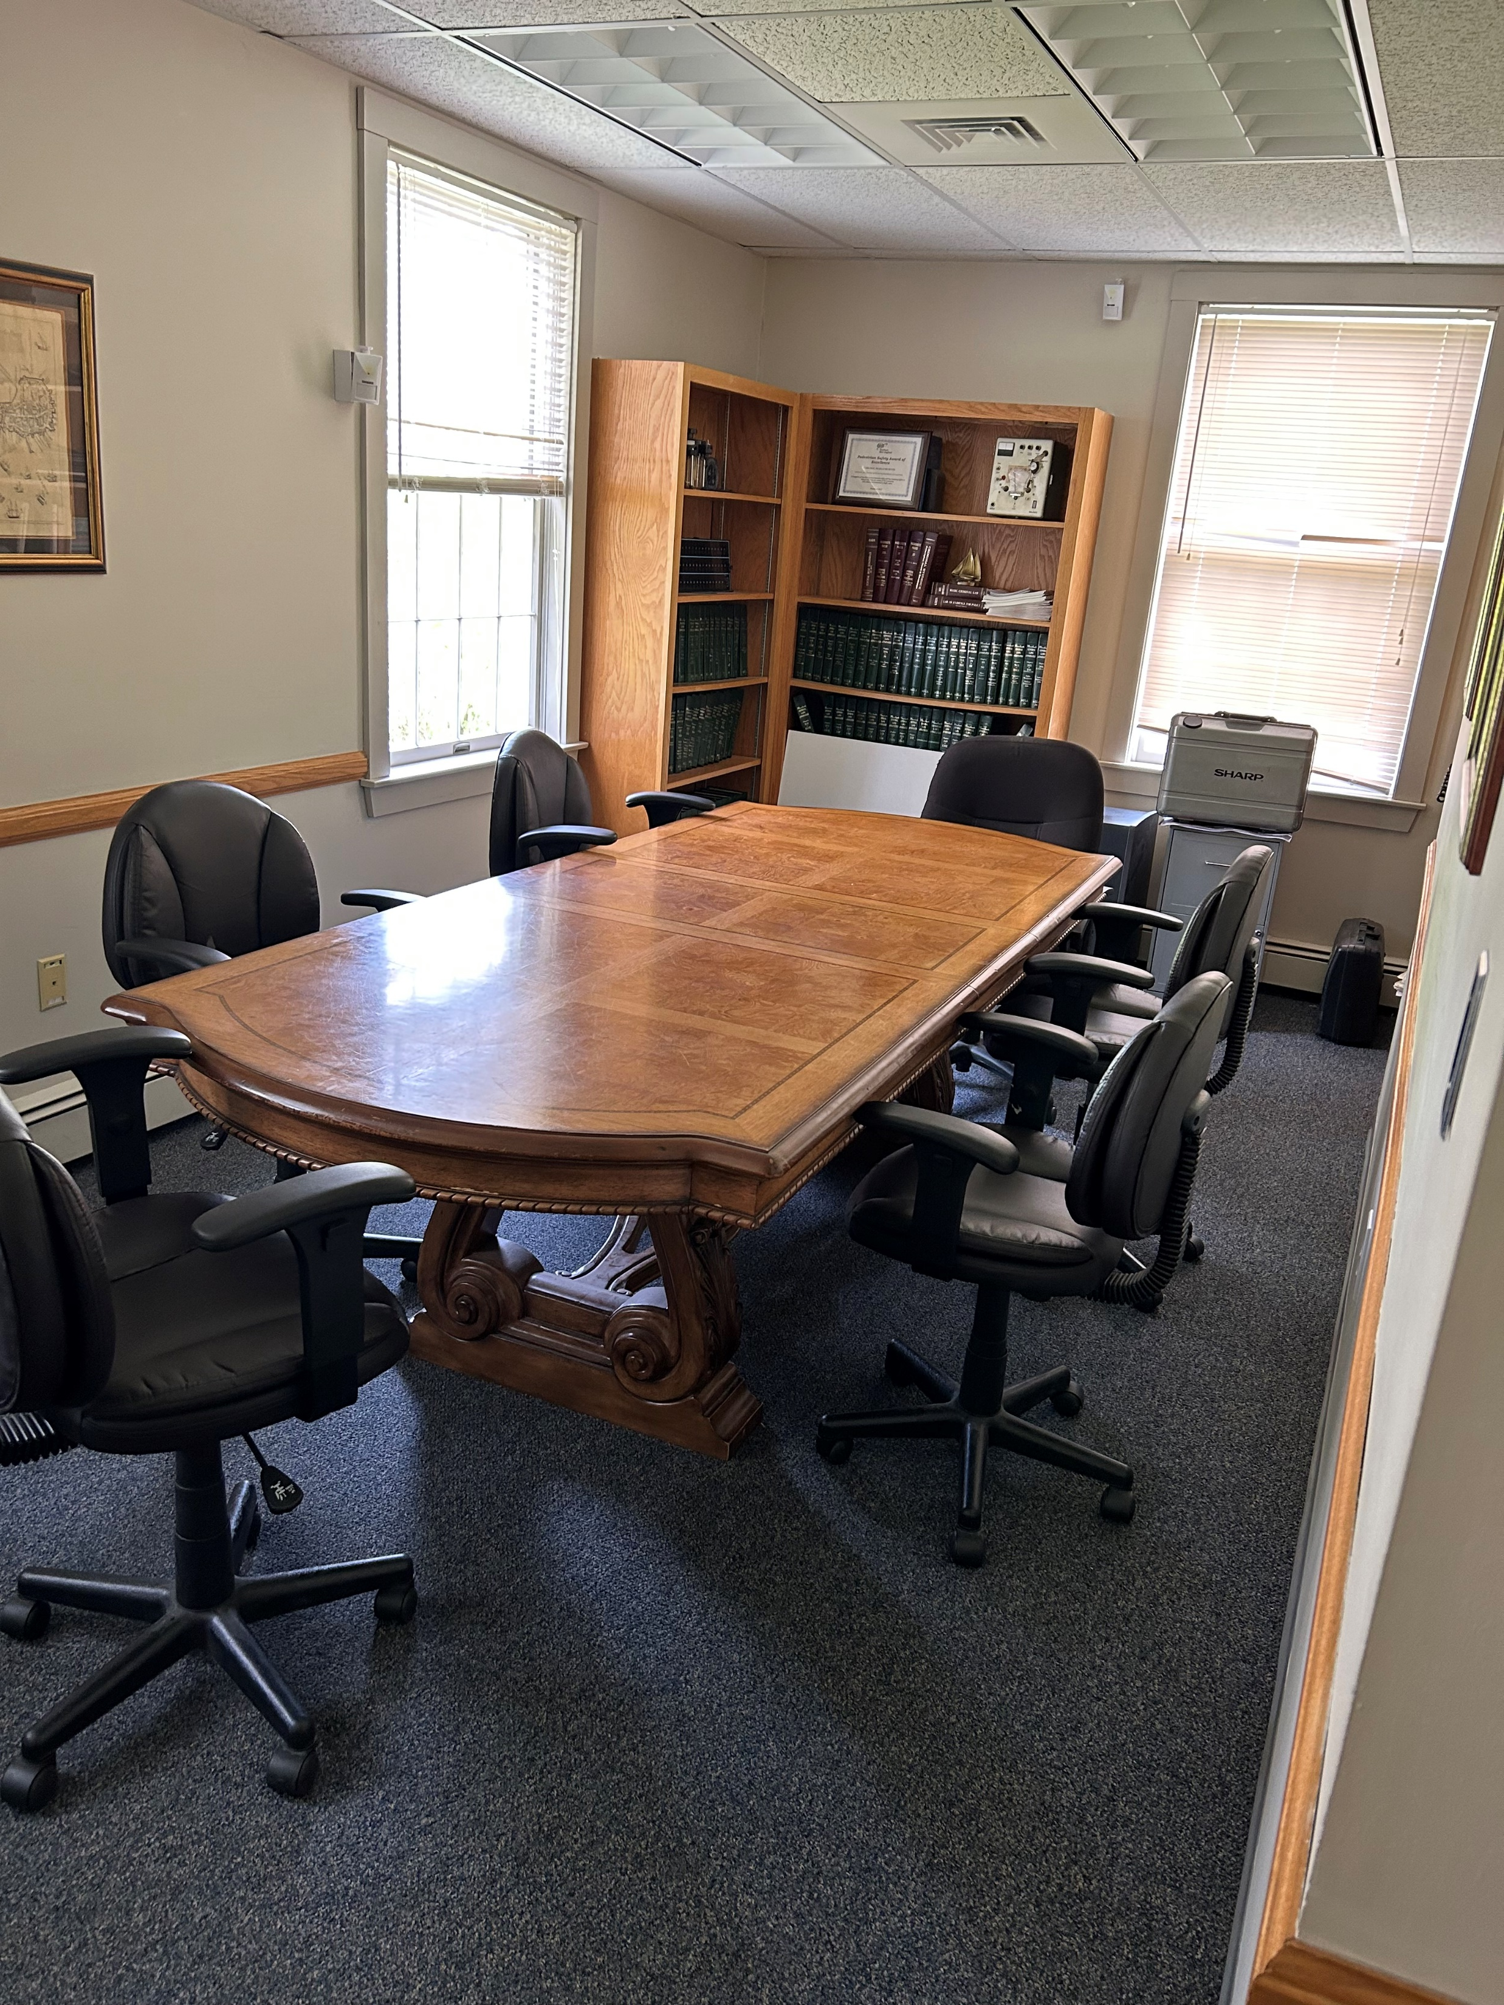
First Floor

Slide 8
First Floor
By removing an unneeded stair, creates a new multi-purpose room that can be used as a training room and a community room
New accessible public restroom in the station lobby
Adds a new interview room for custodial and noncustodial interviews
Creates an open space office for all 3 Sergeants
Develops a secure corridor to prevent access by nonemployees

Slide 9
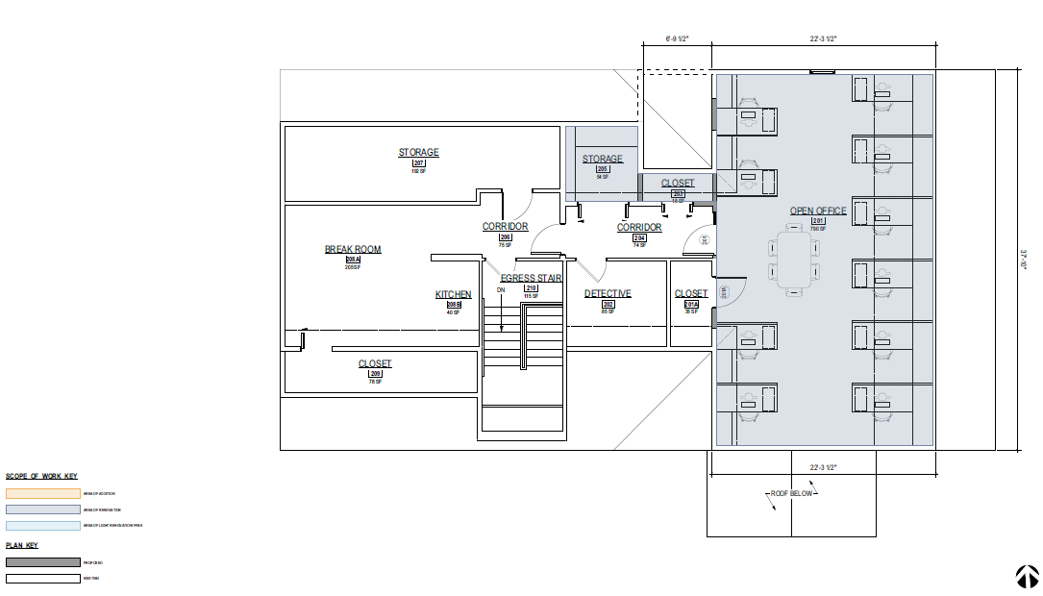
Second Floor

Slide 10
Second Floor
Creates a large open office floor plan for officer workstations
Efficiently reconfigures storage space

Slide 11
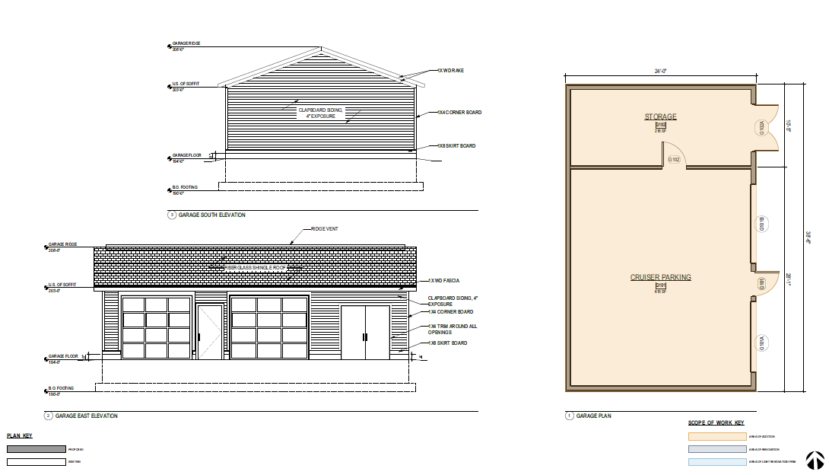
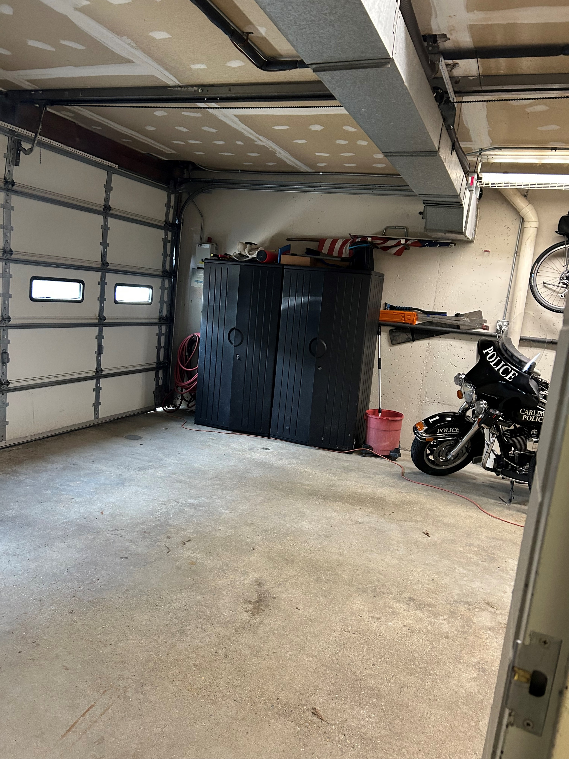
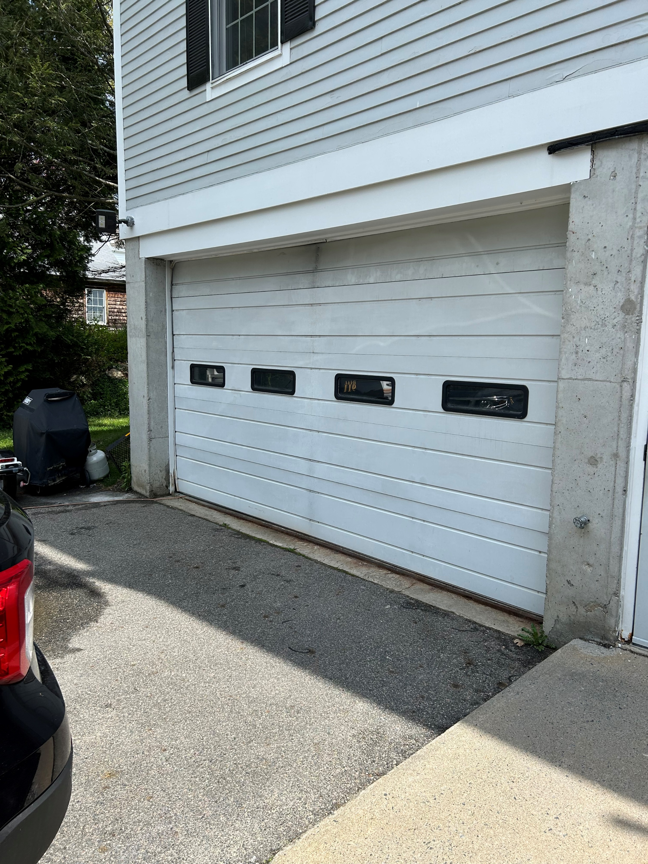
Garage

Slide 12
Garage
Additional evidence storage space
Protects capital investments like police cruisers
Increases response times during inclement weather

Slide 13
Conclusion
Meets officer safety and state accreditation compliance
Renovated locker rooms address equity concerns and improve recruitment
Adds a multi-purpose room, providing needed community meeting and officer training space
Addresses aging building systems, reducing future costs for these projects
Increases Town sustainability by adding heat pumps and wiring for electric chargers/solar
Serves as a generational solution for $171 per year to the average Carlisle home

