Slide 1

Police Station Renovation Project

Slide 2
Project History
FALL 2023: The Select Board reengaged with this project, building on previous work to create a cost-efficient recommendation for Town Meeting consideration
DECEMBER 2023: The Select Board clarified renovation goals then engaged with TBA Architects to create a conceptual design and cost estimate
JANUARY 2024: The Police Station Building Renovation Committee (PSBRC) was established to finalize the project’s construction documents confirm renovation costs
APRIL 2024: TBA completed the project’s construction document and brought a final project estimate to the Select Board for consideration
MAY 2024: Annual Town Meeting and Town Election Vote

Slide 3
Project Goals
Modernize the police station to meet accreditation goals, increase retention/recruitment efforts, and improve officer and resident safety
Increase gender parity by expanding female locker room space
Create a community room that connects the department with residents and provides a safe and usable town resource
Upgrade aging building systems to meet the Town’s financial and sustainability goals as identified in the Master Plan

Slide 4
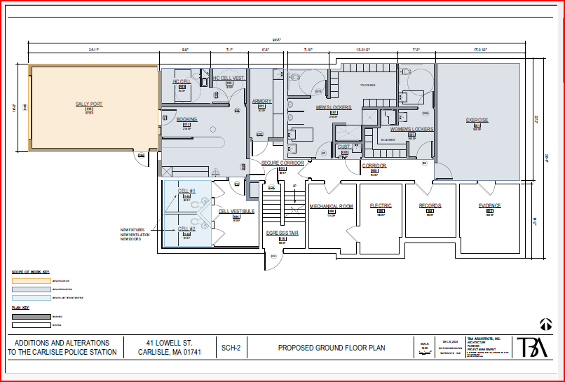
Ground Floor

Slide 5
Ground Floor
Creates a modernized, accessible, and safe booking room/holding cell area for processing prisoners
The proposed design complies with the Massachusetts Police Accreditation Commission
Will be code compliant with Department of Public Health, Town Building Codes, and Sustainability best practices
Increases gender parity by creating more space for female officers

Slide 6
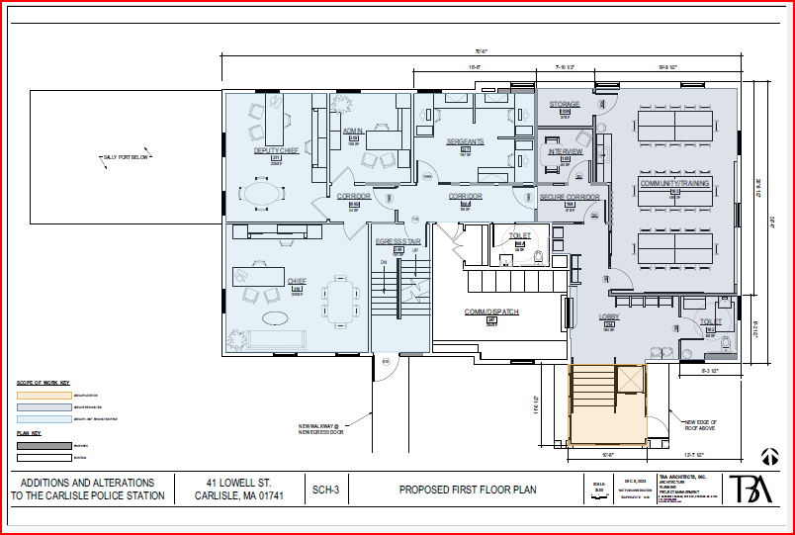
First Floor

Slide 7
First Floor
Creates a new Community Room space for resident use
Creates a Police Training Room for courses and training
New safe and accessible public restroom in the lobby
Adds a new interview room for custodial and noncustodial interviews
Creates an open space office for all 3 Sergeants
Develops a secure corridor to prevent access for nonemployees

Slide 8
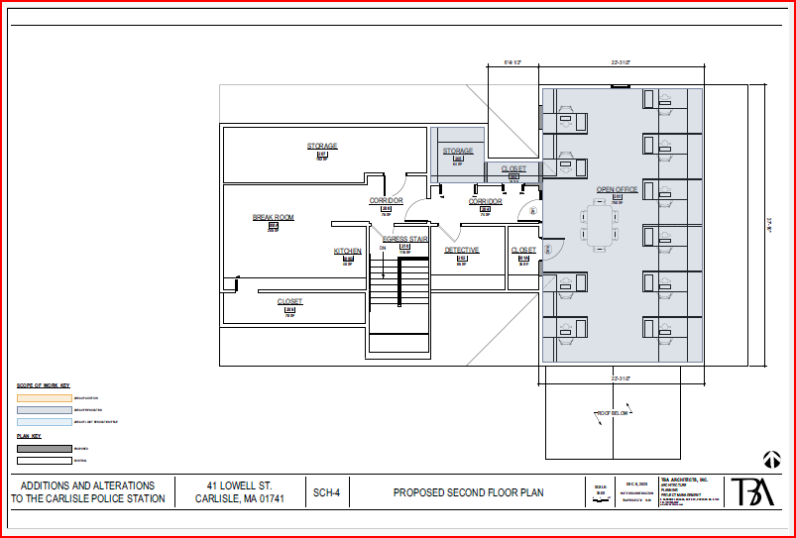
Second Floor

Slide 9
Second Floor
Creates a large open office floor plan for officer workstations
Efficiently reconfigures storage space

Slide 10
Financial Considerations
Carlisle residents are asked to support this project with two votes:
1.) Annual Town Meeting Article # 13
2.) Town Election Ballot Question # 2
The total project cost is $XX. The Town will borrow to pay for this project.
The cost of this borrowing to the average Carlisle household is $134 per year, declining annually for the length of the loan (30-year projection)

Slide 11
Conclusion
The revised layout increases officer safety and meets state accreditation compliance.
The design features new locker rooms that address equity concerns and improve recruitment efforts
The community room will be versatile, accommodating 40+ people, and further connecting police officers to residents of all ages.
Building system upgrades meet the Town’s financial and sustainability goals (Master Plan). The all-electric upgrades makes these necessary systems improvements more environmentally responsible
The Select Board’s proposed project represents the most cost-effective solution to a long-term issue, investing in a generational renovation for $134 per year to the average Carlisle home

